Slide 1
Teacher Evaluation and Rating management (TERM) Design
By Alexander Treacy – S15106436
Bachelor of science with honours – computer science

Slide 2
Introduction to application
The iOS application will improve the learning environment for students and teachers using a basic slider for students to give feedback on teaching staff.
Students will have the ability to rate a teacher on lecturers/sessions based on how useful the session was, understandability of the session, and how engaging it was.
Teachers will be able to give out a unique code to students who are in the current class and will be able to view this feedback (given as an average from the entire class).

Slide 3
iOS application Features and frameworks
ACCOUNTS FRAMEWORK: All users will have to log in before accessing any of the main application features either as a teacher or a student.
WEB SERVICES: To be able to log in to the application. The unique code will be given once the student is logged in. The user must be connected through a web service.
DATA PERSISTENCE: The user will be able to export data from the application in a graph or text form to see if they have improved since getting feedback from students.

Slide 4
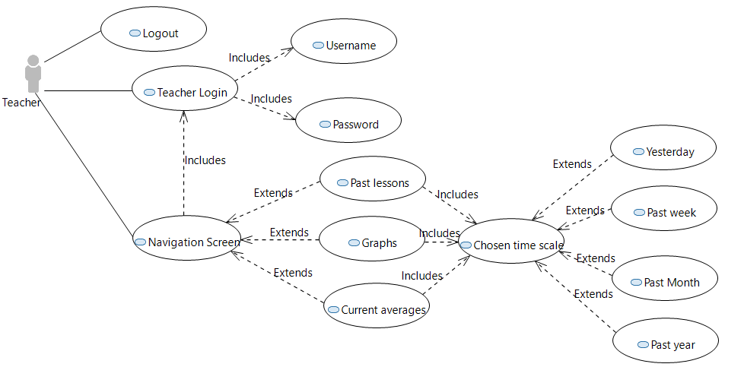
UML diagram for teachers

Slide 5
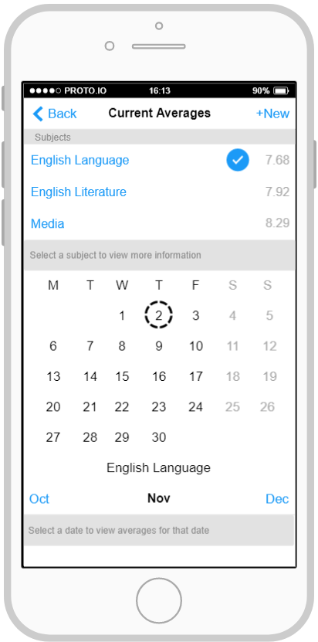
User interface - Teacher
Teachers can view different lessons which they teach and see their current score of this subject. New subjects can be added at any time.
A subject can be selected so that the calendar is visible with todays date circled.
Teachers can also choose to select a specific date to view their average score for that date.

Slide 6
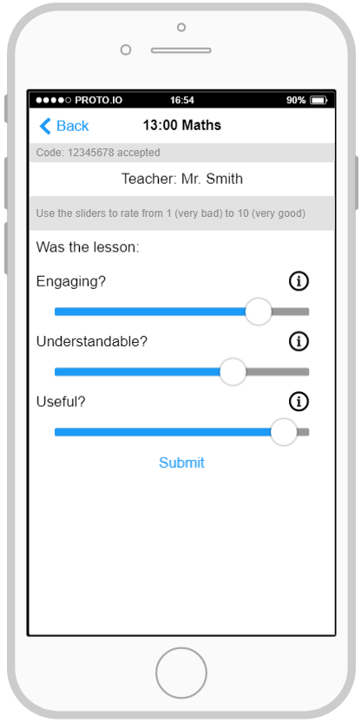
User Interface - Students
Students will be able to rate teachers using a simple, yet functional design.
A lesson will be selected and the student will be prompted to enter a code (given to them by the respective teacher)
As the application is to be integrated into schools there is additional information available based on each slider category (telling the user what each slider means).
All screens will comply with Apple’s iOS Human Interface Design Guidelines.

Slide 7
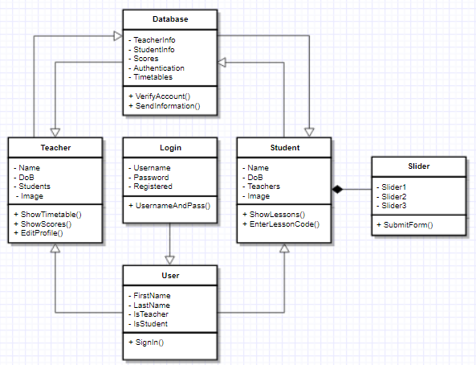
Application Design
Class design for teachers and students for logging in, sending data to and from the database and for the slider screen.

Slide 8
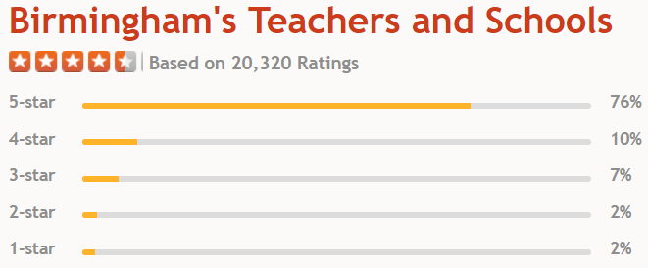
Architecture and API’s
One API to be used is the Facebook API (Facebook Swift SDK by Facebook) so that teachers may share their current average score or their score over a certain amount of time with other teachers/staff over Facebook (this includes the XCode workspace).
The dataset for student feedback on teachers will be simulated using information from uk.ratemyteachers.com. This information will be used for assuming averages of teachers ratings in Birmingham.

Slide 9
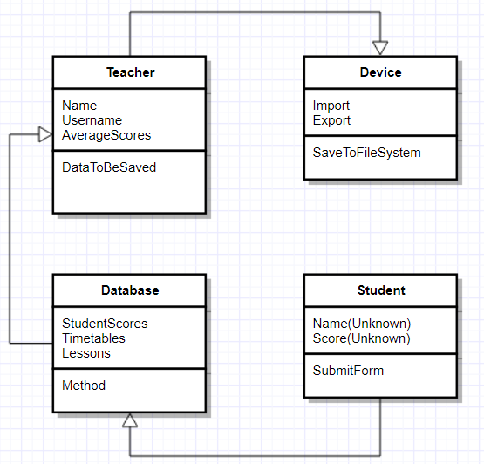
Device data and Data persistence
Storing data on the device I the most cost effective way of storing simple authentication data and any data needed to be exported from the app.
Important data will be able to be saved locally such as teacher ratings.

Slide 10
Future challenges
Device authentication to ensure a secure connection with teachers could be used in the future as well as a feature for students to create an account just by using their school login username and password.
Additionally teachers could give feedback on students using the application so that the student know where they may be going wrong or if they were not involved enough in lessons.

Slide 11
References
Best Schools in Birmingham. RateMyTeachers uk.ratemyteachers.com. (2017). Best Schools in Birmingham. RateMyTeachers. [online] Available at: https://uk.ratemyteachers.com/Birmingham. [Accessed 5 Nov. 2017].

